Slide 1

Contextual Bandit Learning: Exploration and Exploitation with Context
Manoj Hanumanthu
1566325
Guided By: Prof. Indraneel Pole / Andreas Pech

Slide 2
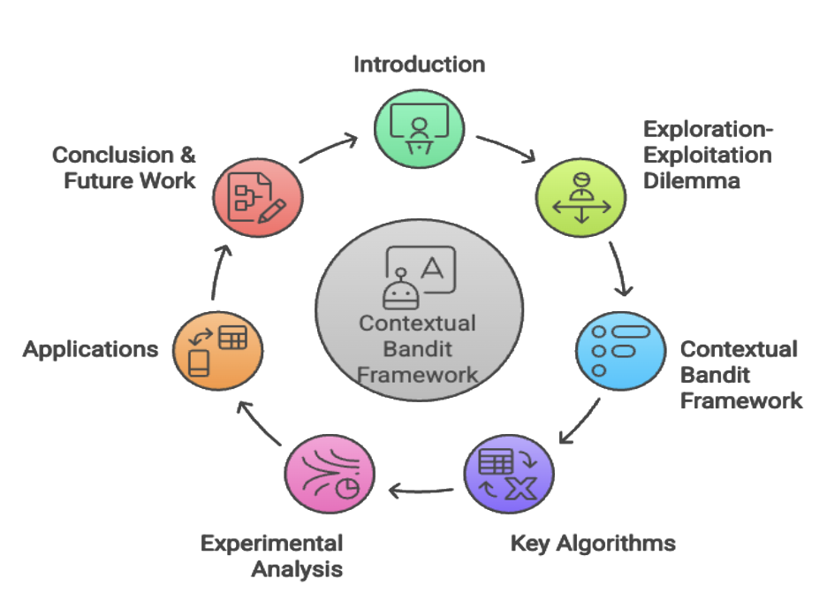
Agenda
Introduction
Exploration-Exploitation Dilemma
Contextual Bandit Framework
Key Algorithms
  ε-Greedy
  Linear UCB
  Thompson Sampling
Experimental Analysis
  Dataset design
  Parameter tuning
  Results
Applications
Conclusion & Future Work
Source: NakinAi

Slide 3
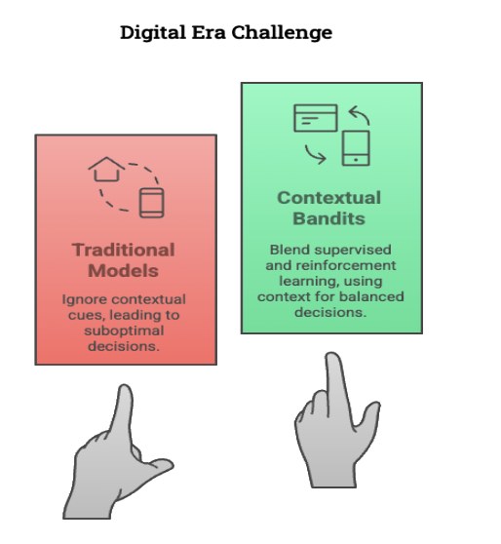
Introduction
Hybrid approach:
  Combines Supervised Learning + Reinforcement Learning.
  Uses contextual cues (e.g., user profile, environment) to guide actions.
Solves the classic trade-off between:
  Exploitation – Use known best options
  Exploration – Try new options to learn more
Enables continuous learning for better long-term outcomes.
Ideal for real-time, personalized decision-making in uncertain environments.
Widely used in recommendation engines, ad placement, and dynamic pricing.
Source: NakinAi

Slide 4
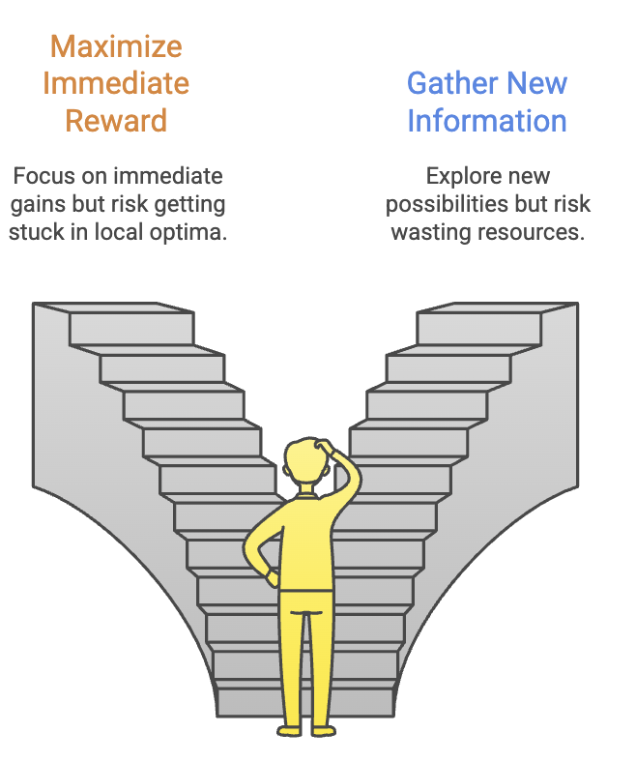
Exploration-Exploitation Dilemma
Core Conflict:
  Exploitation: Maximize immediate reward (risk: local optima).
  Exploration: Gather new information (risk: wasted resources).
Impact of Imbalance:
  Over-exploration: Missed opportunities
  Over-exploitation: Stagnant learning
Algorithm Studied
  ε-Greedy | Linear UCB | Thompson Sampling
Each algorithm offers a unique strategy to manage uncertainty and learn optimally over time.
Source: NakinAi

Slide 5
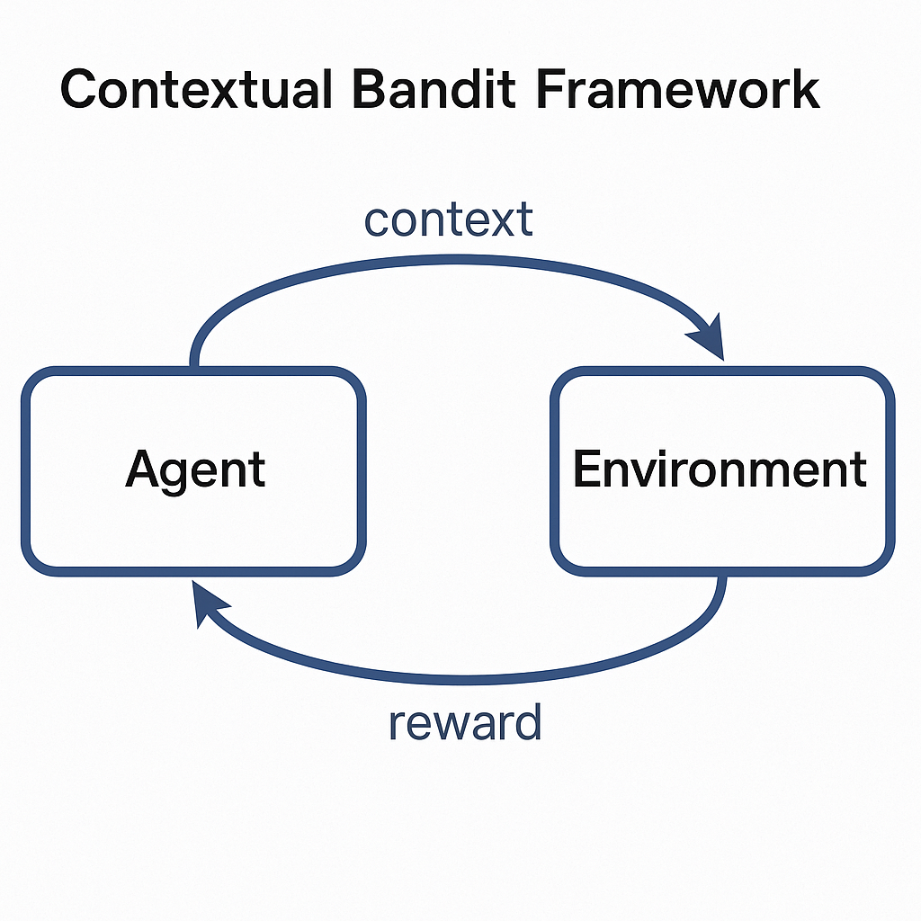
Contextual Bandit Framework
Extends the classic multi-armed bandit problem by adding contextual information.
In each round:
  Environment provides context (e.g., user profile, time, location).
  Agent selects an action (arm) based on the current context.
  Reward is observed for the chosen context–action pair.
Agent uses this outcome to update its policy and improve future decisions.
This loop continues, enabling the agent to learn which actions work best under different contexts.
Result: Adaptive, context-aware decision-making that improves over time.

Slide 6
Problem Formulation
The contextual bandit problem is a sequential decision-making framework where an agent selects
actions based on observed contextual information to maximize cumulative reward. At each time step t, the agent receives a context vector xₜ, selects an action aₜ from a fixed set of arms, and receives a corresponding reward rₜ(aₜ).
The goal is to minimize cumulative regret, defined as:
R(T) = ∑ₜ [rₜ(a*ₜ) - rₜ(aₜ)],
where a*ₜ is the optimal action for context xₜ.
However, a key limitation is bandit feedback—the agent only observes the reward for the action it chose, not for other possible actions, making learning more challenging.

Slide 7
Algorithms Overview
Algorithm | Exploration Method | Key Assumptions | Strengths | Limitations
ε-Greedy | Random exploration (ε) | Fixed reward estimates per arm | Simple, low computational cost, easy to implement | Static ε, inefficient in complex contexts
Linear UCB | Confidence-bound optimization | Linear reward-context relationship | Theoretically grounded, adaptive, interpretable | Requires matrix ops, assumes linearity
Thompson Sampling | Posterior sampling (Bayesian) | Prior distribution on rewards | Probabilistic, adaptive, strong empirical performance | Sensitive to priors, computationally more intensive

Slide 8
ε-Greedy Algorithm
Balances exploration and exploitation by:
  Choosing the best-known action with probability (1−ε)
  Choosing a random action with probability ε
In contextual bandits, uses a linear model to estimate expected rewards and occasionally explores non-optimal arms.
Strengths:
  Simple to implement and understand
  Low computational cost
  Acts as a reliable baseline
Limitations:
  Fixed ε may cause too much or too little exploration
  Doesn’t model uncertainty
  Less effective in high-dimensional or complex settings

Slide 9
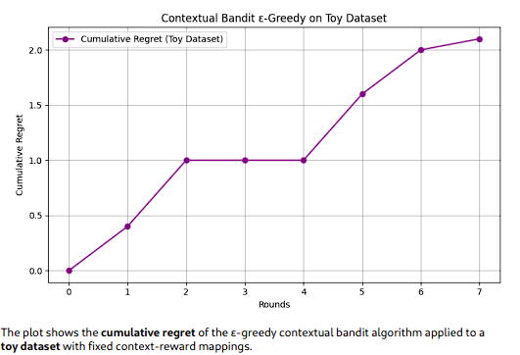
Regret Visualization

Slide 10
Linear UCB Algorithm
Selects actions using optimism under uncertainty:
  Action score = Estimated Reward + α × Confidence Bound
Assumes expected reward is a linear function of context.
Parameter α controls the balance between exploration and exploitation.
  The confidence bound quantifies uncertainty, encouraging exploration where the model is less certain.
  By prioritizing actions with high upper confidence bounds, it avoids premature exploitation.
  Provides strong theoretical guarantees, making it robust in many practical applications.
Strengths:
  Theoretically grounded with sublinear regret guarantees
  Automatically balances exploration and exploitation
  Excels in structured, high-dimensional contexts

Slide 11
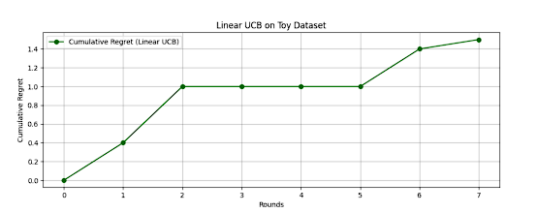
Regret Interpretation
Regret initially increases during exploration, then stabilizes as confidence bounds narrow. The plot shows consistently lower cumulative regret than ε-Greedy, indicating more efficient and faster learning over time.

Slide 12
Thompson Sampling
Thompson Sampling (TS):
  A Bayesian exploration strategy that selects actions based on the probability of being optimal.
  At each step, samples parameters from the posterior distribution of each arm and picks the arm with the highest predicted reward.
Working Mechanism:
  Models reward as a probabilistic function of context.
  Updates posterior distributions after every action and observed reward.
  Exploration naturally arises from model uncertainty.
Strengths:
  Adaptive and inherently probabilistic exploration
  Excels in uncertain or sparse-data environments
  Requires no manual tuning of exploration parameters like ε or confidence bounds
Performance:
  Starts with variability due to stochastic sampling
  Regret decreases over time as the model learns
  Often matches or outperforms others, especially in dynamic or personalized contexts

Slide 13
Experimental Setup
Custom Toy Dataset for Evaluation
Purpose:
  Simulates a realistic but controlled decision-making environment
  Designed for clarity, interpretability, and experimental control
Context Generation:
  Each round provides a context vector (5–10 dimensions)
  Sampled from uniform or multivariate normal distribution
  Mimics real-world features like user traits or environmental signals
Arm-Reward Mapping:
  Each arm has a hidden weight vector (linear reward function)
  Reward = dot product of context and weight + Gaussian noise
  Adds realistic variability and enables tracking of:
    Learning behavior
    Reward accumulation
    Cumulative regret minimization

Slide 14
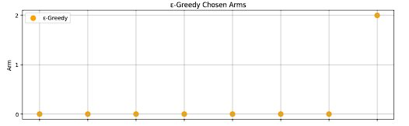
Arm-Reward Matrix
The Arm-Reward Matrix is a structured representation that maps how each action (arm) performs under different contexts. It is a core component of the contextual bandit setup, capturing the expected reward for every possible context-arm pair.
Definition and Purpose
Each row represents an arm (action), and each column corresponds to a context instance.
Matrix entries contain expected rewards computed via a linear reward model with added noise.
Enables evaluation of algorithm performance by comparing chosen actions to optimal ones.

Slide 15
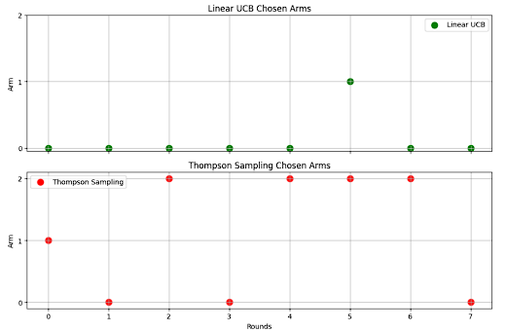
Visual Representation:
Highlights which arms dominate in specific context regions.
Shows reward overlaps between arms, helping to assess exploration difficulty and ambiguity in decision-making.
Used to calculate and visualize regret, action relevance, and algorithm behavior across different learning phases.

Slide 16
Exploration Parameter Tuning
ε-Greedy:
  Uses fixed or decaying ε (e.g., ε = 0.1 or ε ↓ over time)
  High ε → too much exploration, slower learning
  Low ε → risk of premature exploitation
  Decay strategy balances exploration-exploitation over time
Linear UCB:
  Exploration governed by parameter α (confidence bound scaling)
  Low α → not enough exploration
  High α → over-exploration and noise sensitivity
  Optimal performance often around α ≈ 1.0
Thompson Sampling (TS):
  Exploration via posterior sampling
  Influenced by prior distribution and reward noise variance (σ²)
  Broad priors → strong early exploration
  Accurate σ² estimation improves learning stability

Slide 17
Sensitivity Summary Table:
Algorithm | Parameter | Role | Sensitivity Impact
ε-Greedy | Ε | Random exploration rate | High ε delays learning; low ε may lock into suboptimal arms
Linear UCB | Α | Confidence interval scaling | Low α reduces learning; high α causes over-exploration
Thompson Sampling | Prior, σ² | Posterior sampling noise | Misestimated priors affect convergence and accuracy

Slide 18
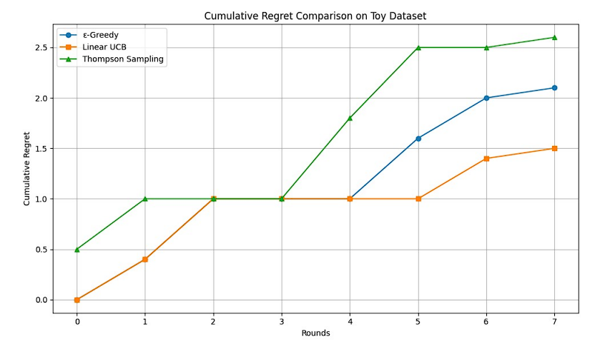
Results
Linear UCB shows the lowest cumulative regret, indicating fast, stable learning.
Thompson Sampling starts with high variance but catches up effectively.
ε-Greedy shows higher regret, especially with fixed ε, due to less adaptive exploration.

Slide 19
Conclusion & Future Work
This study provides a comparative analysis of ε-Greedy, Linear UCB, and Thompson Sampling within a controlled contextual bandit framework. Key findings highlight that Linear UCB offers the best balance between exploration and exploitation, Thompson Sampling adapts well over time through Bayesian reasoning, and ε-Greedy, while simple, lacks adaptability.
These insights have practical relevance for real-world applications like personalized recommendations, online A/B testing, clinical decision-making, and adaptive pricing.
For future work, we propose:
Using dynamic exploration parameters (adaptive ε or α) to handle non-stationary environments.
Extending to Deep Contextual Bandits with neural networks to capture complex, non-linear reward structures.
Applying these algorithms on real-world datasets to test scalability and robustness in production systems.

Slide 20
THANK YOU

Slide 21
References
O. A. Hanna, L. F. Yang, C. Fragouli, G. Neu, and L. Rosasco, "Contexts can be Cheap: Solving Stochastic Contextual Bandits with Linear Bandit Algorithms," Jul. 12, 2023, PMLR. Accessed: May 30, 2025. [Online]. Available: https://proceedings.mlr.press/v195/hanna23a (Covers contextual bandit framework & linear bandits)
A. Elwood, M. Leonardi, A. Mohamed, and A. Rozza, "Maximum Entropy Exploration in Contextual Bandits with Neural Networks and Energy Based Models," Entropy, vol. 25, no. 2, p. 188, Jan. 2023, doi: 10.3390/E25020188 (Exploration-exploitation strategies)
[M. Pancini, "Enhancing Data Preparation with Adaptive Learning: A Contextual Bandit Approach for Recommender Systems," DEGREE PROJECT IN TECHNOLOGY, 2024, Accessed: May 30, 2025. [Online].(Recommender system applications)
Y. Varatharajah and B. Berry, "A Contextual-Bandit-Based Approach for Informed Decision-Making in Clinical Trials," Life, vol. 12, no. 8, p. 1277, Aug. 2022, doi: 10.3390/LIFE12081277 (Healthcare applications)

Slide 22
C. Wang, L. Shi, and J. Luo, "Adaptive Noise Exploration for Neural Contextual Multi-Armed Bandits," Algorithms, vol. 18, no. 2, p. 56, Jan. 2025, doi: 10.3390/A18020056 (Experimental noise modeling)
"Comparing bandit algorithms in static and changing environments | TU Delft Repository." Accessed: May 30, 2025. [Online]. Available: https://repository.tudelft.nl/record/uuid:9886f249-60dc-4d69-8055-49edf5b4350a (Algorithm comparisons in experiments)
H. Tran-Dang, K. H. Kwon, and D. S. Kim, "Bandit Learning-Based Distributed Computation in Fog Computing Networks: A Survey," IEEE Access, vol. 11, pp. 104763–104774, 2023, doi: 10.1109/ACCESS.2023.3314889 (IoT applications)
J. Zheng, H. Gao, H. Dai, Z. Zheng, and F. Wu, "Neural Contextual Combinatorial Bandit under Non-stationary Environment," Proc. IEEE ICDM, pp. 878–887, 2023, doi: 10.1109/ICDM58522.2023.00097 (Non-stationary environments for future work)
Y. Ban, Y. Yan, A. Banerjee, and J. He, "Neural Exploitation and Exploration of Contextual Bandits," May 2023, Accessed: May 30, 2025. [Online]. Available: https://arxiv.org/pdf/2305.03784 (Deep contextual bandits for future work)
Z. Tian, "Bandit Algorithms for Advertising Optimization: A Comparative Study," ITM Web Conf., vol. 73, p. 01019, Feb. 2025, doi: 10.1051/ITMCONF/20257301019 (Advertising applications)

